Slide 1
Automating your IT Workflow
Presented By: Stephen Valdinger
IT User Support Analyst @ Kent State Tuscarawas
2/23/2017

Slide 2
Why do we automate?
Remove Human Error
Expedite repetitive tasks
More efficient reporting
Ease Administrative burden

Slide 3
What can we automate?
Employee Onboarding/Termination
System configuration settings (DSC, Puppet, Chef)
Reporting
The list goes on and on and on……..

Slide 4
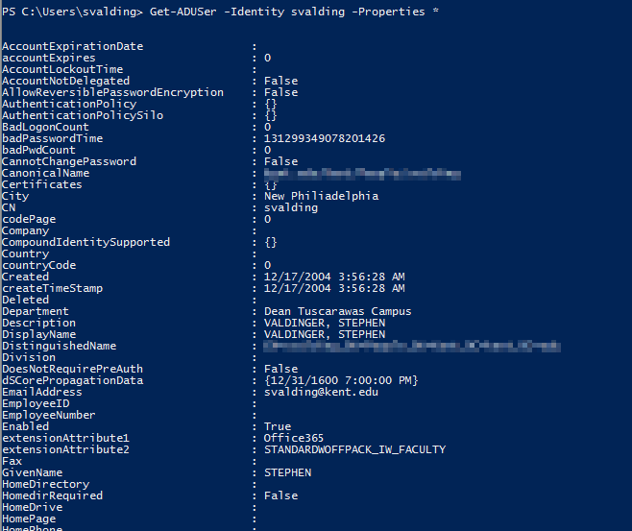
Powershell syntax
Powershell uses a verb-noun cmdlet syntax which makes things easy to understand
You Get-Something, Invoke-Something, Add-Something,Remove-Something……
Example:
Get-ADUser –Identity svalding –Properties *
Result:

Slide 5
Working Example – Find all user accounts who logged in over 30 days ago
Import-Module ActiveDirectory
function Get-ADUsersLastLogon()
{
$dcs = Get-ADDomainController -Filter {Name -like “dc fqdn"}
$users = Get-ADUser -Filter *
$time = (Get-Date).AddDays(-30)
$exportFilePath = "c:\temp\lastLogon.csv"
$columns = "name,username,datetime"
Out-File -filepath $exportFilePath -force -InputObject $columns
foreach($user in $users)
{
foreach($dc in $dcs)
{
$hostname = $dc.HostName
$currentUser = Get-ADUser $user.SamAccountName | Get-ADObject -Server $hostname -Properties lastLogon
if($currentUser.LastLogon -gt $time)
{
$time = $currentUser.LastLogon
}
}
$dt = [DateTime]::FromFileTime($time)
$row = $user.Name+","+$user.SamAccountName+","+$dt
Out-File -filepath $exportFilePath -append -noclobber -InputObject $row
$time = 0
}
}
Get-ADUsersLastLogon

Slide 6
STOP! Example Time…..(boos welcome)

Slide 7
3rd party patch management
Keep things updated, without the hassle

Slide 8
Various software SOlutions available
PDQ Deploy from Admin Arsenal (Now pdq.com)
System Center Configuration Manager (SCCM) from Microsoft
BatchPatch from Cocobolo Software LLC
Ninite/Ninite Pro from Ninite
We will be focusing on PDQ Deploy and PDQ Inventory

Slide 9
Resources from today’s talk
You can download the example scripts used today, as well as this presentation here: https://github.com/steviecoaster/TuscTechPresentation
You can find more information about PDQ Deploy here: www.pdq.com
You can find some great resources for powershell on Reddit at /r/Powershell and www.powershell.org
Powershell in a Month of Lunches is available on Amazon.com from Manning Press (Includes free eBook with purchase!)

